Slide 1

Semi-Supervised classification with Graph Convolutional Networks
Team 35:
▶Chirag Shameek Sahu(2020121006)
▶ Isha Gupta(2019101111)
▶Ashish Gupta(2019101016)
▶Dinesh Garg (2019101085)
This Photo by Unknow n author is licensed under CC BY-NC.

Slide 2
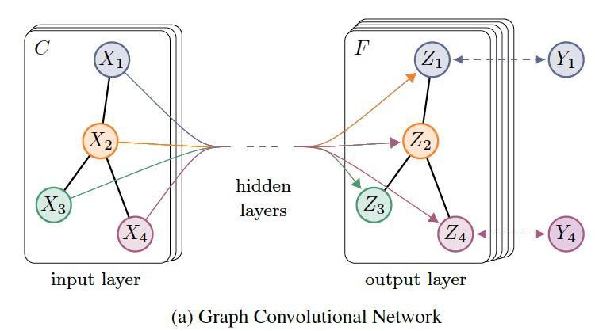
Graph Convolutional Network
The Goal: learn a function of signals/features on a graph 𝐺 = (𝑉, 𝐸)
Input:
▶ A feature description 𝑥_{𝑖} for every node 𝑖; summarized in a 𝑁 × 𝐷 feature matrix 𝑋 (𝑁: number of nodes, 𝐷: number of input feature)
▶ A representative description of the graph structure in matrix form; typically, in the form of an adjacency matrix 𝐴 (or some function thereof)
Output is a node-level 𝑍 (an 𝑁 × 𝐹 feature matrix, where F is the number of output features per node)

Slide 3
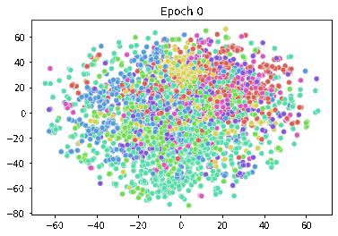


Graph Convolutional Network
Every neural network layer can there be written as a non-linear function
_{𝐻} 𝑙+1
= 𝑓(𝐻 ^{𝑙} , 𝐴)
with 𝐻 ⁰ = 𝑋 and 𝐻 ^{𝐿} = 𝑍 (or 𝑧 for graph-level outputs), 𝐿 being the number of layers. The specific models then differ only in how 𝑓 ∙,∙ is chosen and parameterized.
Cora t-SNE visualization

Slide 4
Loss Function
▶ Using a graph Laplacian regularization term in the loss function
2
= 𝑓 𝑋 ^{𝑇}Δ𝑓 𝑋 .
𝑓 = 𝑓₀ + 𝜆𝑓_{𝑟𝑒𝑔}, with 𝑓_{𝑟𝑒𝑔} = σ_{𝑖,𝑗} 𝐴_{𝑖𝑗} 𝑓 𝑋_{𝑖} − 𝑓 𝑋_{𝑗}
▶ 𝑓₀ denotes the supervised loss with respect to the labelled part of the graph
▶ 𝑓(∙) can be a neural network-like differentiable function
▶ 𝜆 is a weighing factor
▶ 𝑋 is a matrix of node features vectors 𝑋_{𝑖}.
▶ Δ = 𝐷 − 𝐴 denotes the unnormalized graph Laplacian of an undirected graph 𝐺 = (𝑉, 𝐸) with 𝑁 nodes 𝑣_{𝑖} ∈ 𝑉, edges 𝑣_{𝑖}, 𝑣_{𝑗} ∈ 𝐸, adjacency matrix 𝐴 ∈ 𝑅^{𝑁×𝑁} (binary or weighted) and a degree matrix 𝐷_{𝑖𝑖} = σ_{𝑗} 𝐴_{𝑖𝑗}.

Slide 5



Fast Approximate Convolutions on Graphs
_{𝐻} 𝑙+1
1 1
= 𝜎 𝐷^{෡−}2𝐴^{መ}𝐷^{෡−}2𝐻^{𝑙}𝑊^{𝑙}
▶ 𝐴^{መ} = 𝐴 + 𝐼_{𝑁} is the adjacency matrix of the undirected graph 𝐺 with added self- connections.
▶ 𝐼_{𝑁} is the identity matrix
▶
^{𝐷}𝑖𝑖 ^{= σ}𝑗 ^{𝐴መ}𝑖𝑗
_{𝑊} 𝑙
_{𝐻} 𝑙
_{𝐻} 0
is a layer-specific trainable weight matrix
∈ 𝑅^{𝑁×𝐷} is the matrix of activations in the 𝑙^{𝑡ℎ} layer
= 𝑋
▶
▶
▶

Slide 6
Spectral Graph Convolutions
𝑔_{𝜃} ⋆ 𝑥 = 𝑈𝑔_{𝜃}𝑈^{𝑇}𝑥,
▶ Filter 𝑔_{𝜃} = 𝑑𝑖𝑎𝑔(𝜃) parameterized by 𝜃 ∈ 𝑅^{𝑁}
▶ 𝑈 is the matrix of eigenvectors of the normalized graph Laplacian
₋1 ₋1
𝐿 = 𝐼_{𝑁} − 𝐷 ²𝐴𝐷 ² = 𝑈Λ𝑈 , with a diagonal matrix of its eigenvalues Λ
▶ 𝑈^{𝑇}𝑥 being the graph Fourier transform 𝑥.
𝑇
▶ However! Evaluating this is computationally expensive, multiplication with the eigenvector matrix 𝑈 is 𝑂 𝑁 ² and computing the eigen decomposition of
𝐿 in the first place can be expensive for large graphs.

Slide 7
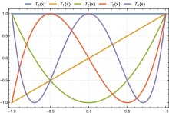


Chebyshev Polynomial Approximation
Rescaled Λ෡ =
2
Λ − 𝐼 .
^{𝜆}𝑚𝑎𝑥
𝑁
𝜆_{𝑚𝑎𝑥} denotes the largest eigenvalue of 𝐿. 𝜃′ ∈
𝑅^{𝐾} is now a vector of Chebyshev coefficients.
The Chebyshev polynomials are recursively defined as
𝑇_{𝑘} 𝑥 = 2𝑥𝑇_{𝑘−1} 𝑥 − 𝑇_{𝑘−2}(𝑥), with 𝑇₀ 𝑥 = 1 and
𝑇₁ 𝑥 = 𝑥.

Slide 8
Chebyshev Polynomial Approximation
𝐾
′
𝑔 ⋆ 𝑥 ≈ ෍ 𝜃 𝑇
L෠ 𝑥 ,
𝘍
𝜃 𝑘 𝑘
𝑘=0
Where L෠ = ² 𝐿 − 𝐼
𝑁
^{𝜆}𝑚𝑎𝑥
can be verified by 𝑈Λ𝑈^{𝑇 𝑘} = 𝑈Λ^{𝑘}𝑈^{𝑇}.
Note that this expression is now 𝐾-localized since it is a 𝐾^{𝑡ℎ}-order polynomial in the Laplacian, i.e., it depends only on nodes that are at maximum 𝐾 steps away from the central node (𝐾^{𝑡ℎ}-order neighborhood).
The complexity of evaluating this is 𝑂 𝐸 , i.e., linear in the number of edges.
Stacking multiple convolutional layers of this form, each layer followed by a point- wise non-linearity.
Limit the layer-wise convolution operation to 𝐾 = 1, i.e., a function that is linear
with respect to 𝐿 and therefore a linear function on the graph Laplacian spectrum.

Slide 9
Further Approx.
▶ Further approximate 𝜆_{𝑚𝑎𝑥} = 2, since neural network parameters will adapt to this change in scale during training, the above equation simplifies to
′ ′
1 1
𝑔 𝘍 ⋆ 𝑥 ≈ 𝜃 𝑥 + 𝜃 𝐿 − 𝐼_{𝑁} 𝑥 = 𝜃′ 𝑥 − 𝜃′𝐷⁻2𝐴𝐷⁻2𝑥,
𝜃 0 1 0 1
with two free parameters 𝜃′ and 𝜃′. The filter parameters can be shared over
0
1
the whole graph.
▶ Successive application of filters of this form then effectively convolve the 𝑘^{𝑡ℎ}- order neighborhood of a node, where 𝑘 is the number of successive filtering operations or convolutional layers in the neural network model

Slide 10
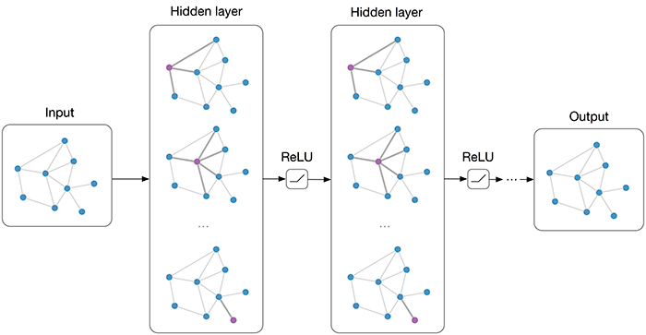
Further Approx.
1 1
𝑔_{𝜃} ⋆ 𝑥 ≈ 𝜃 𝐼_{𝑁} + 𝐷⁻2𝐴𝐷⁻2 𝑥,
▶ with a single parameter 𝜃 = 𝜃′ = −𝜃′
0 1
₋1 ₋1
▶ 𝐿 = 𝐼_{𝑁} − 𝐷 ²𝐴𝐷 ² now has eigenvalues in the range [0,2] that suggest a renormalization trick, to address numerical instabilities, and/or vanishing/exploding gradients
𝐼_{𝑁} + 𝐷⁻2𝐴𝐷⁻2 → 𝐷^{෩ −}2 𝐴^{ሚ}𝐷^{෩ −}2
𝐴^{ሚ} = 𝐴 + 𝐼_{𝑁} and 𝐷^{෩}_{𝑖𝑖} = σ_{𝑗} 𝐴^{ሚ}_{𝑖𝑗}
1 1 1 1

Slide 11
Output
▶ We can generalize the above to a signal 𝑋 ∈ 𝑅^{𝑁×𝐶} with 𝐶 input channels (i.e., a
𝐶-dimensional feature vector for every node) and 𝐹 filters or feature as follows:
1 1
𝑍 = 𝐷^{෩ −} 𝐴𝐷⁻ 𝑋Θ,
2 ሚ෩ 2
where Θ ∈ 𝑅^{𝐶×𝐹} is now a matrix of filter parameters and 𝑍 ∈ 𝑅^(𝑁 × 𝐹) is the convolved signal matrix. This filtering operation has complexity 𝑂 𝐸 𝐹𝐶

Slide 12
Semi-Supervised Node Classification
▶ The forward model is then:
𝑍 = 𝑓 𝑋, 𝐴 = 𝑠𝑜𝑓𝑡𝑚𝑎𝑥 𝐴^{መ}𝑅𝑒𝐿𝑈 𝐴^{መ}𝑋𝑊 ⁰
where they first compute in pre-processing:
1 1
𝐴^{መ} = 𝐷^{෩ −} 𝐴𝐷⁻
2 ሚ෩ 2
_{𝑊} 1

Slide 13
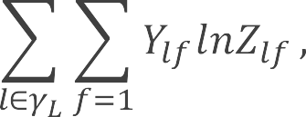
Semi-Supervised Node Classification
𝑍 = 𝑓 𝑋, 𝐴 = 𝑠𝑜𝑓𝑡𝑚𝑎𝑥 𝐴^{መ}𝑅𝑒𝐿𝑈 𝐴^{መ}𝑋𝑊 ⁰
_{𝑊} 1
Here, 𝑊 ⁰ ∈ 𝑅^{𝐶×𝐻} is an input-to-hidden weight matrix for a hidden layer with 𝐻
feature maps. 𝑊 ¹ ∈ 𝑅^{𝐻×𝐹} is a hidden-to-output weight matrix
For semi-supervised multi-class classification, they evaluate the cross-entropy error over all labelled examples as:
where 𝛾_{𝐿} is the set of node indices that have labels.

Slide 14
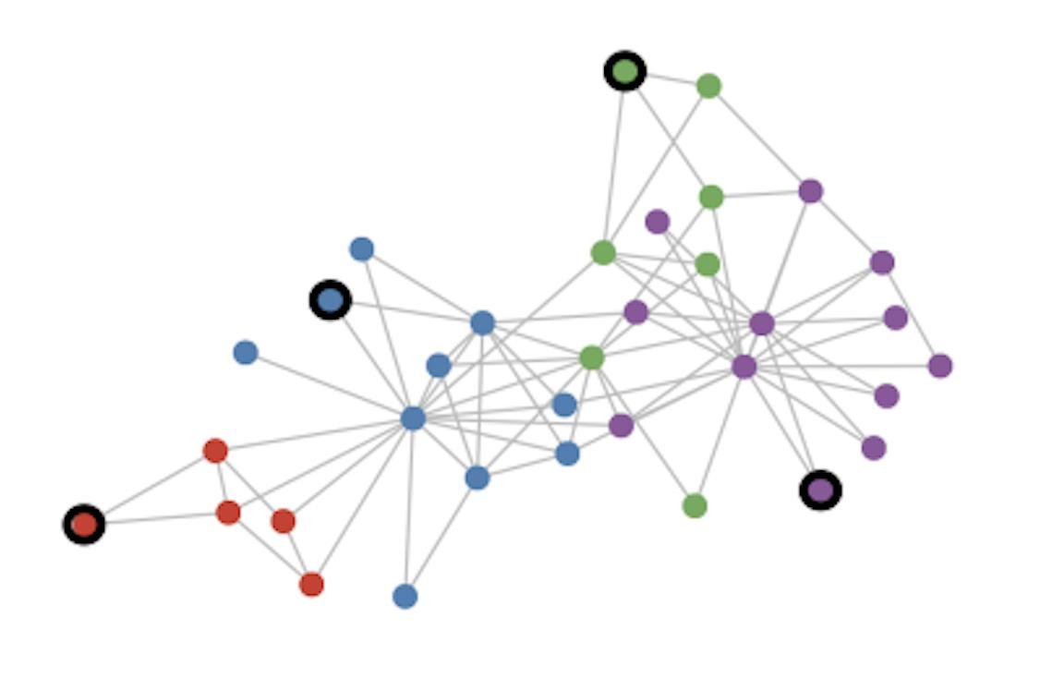
Semi-Supervised Node Classification for graphs
Setting:
Some node are labeled (black circle) All other nodes are unlabeled
Task:
Predict nodes label of unlabeled nodes
Evaluate loss on labeled nodes only:
𝐹
𝑓 = − ෍ ෍ 𝑌_{𝑙𝑓}𝑙𝑛𝑍_{𝑙𝑓} ,
𝑙∈𝛾_{𝐿} 𝑓=1
𝛾_{𝐿} set of labeled node indices
𝑌 label matrix
𝑍 GCN output (after softmax)

Slide 15
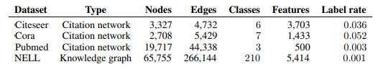
Experimental Set Up
We have used Cora and Pubmed datasets.

Slide 16
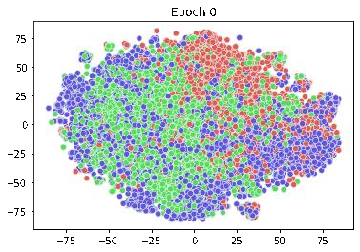
Results
 | Test Accuracy | CORA | PUBMED
 | 200 - iterations | 80.30% | 78.70%
Pubmed t-SNE visualization
Cora t-SNE visualization

Slide 17
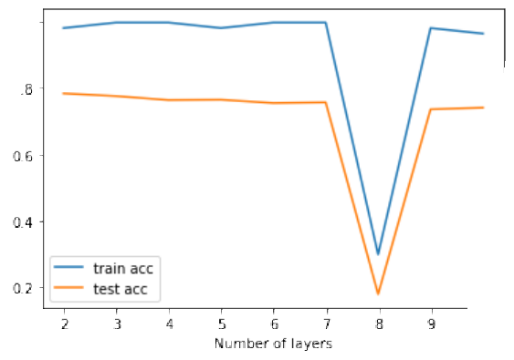
Results
Model depth experiment

Slide 18
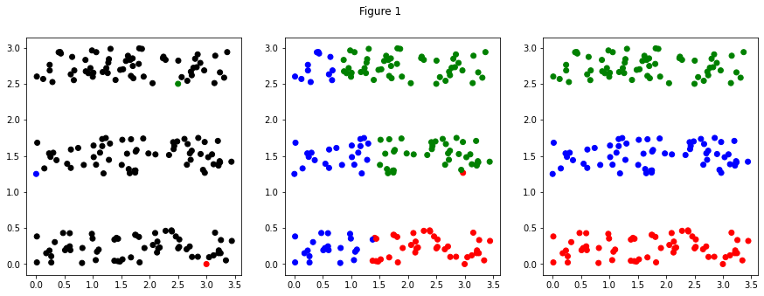
Results
Label Propagation

Slide 19
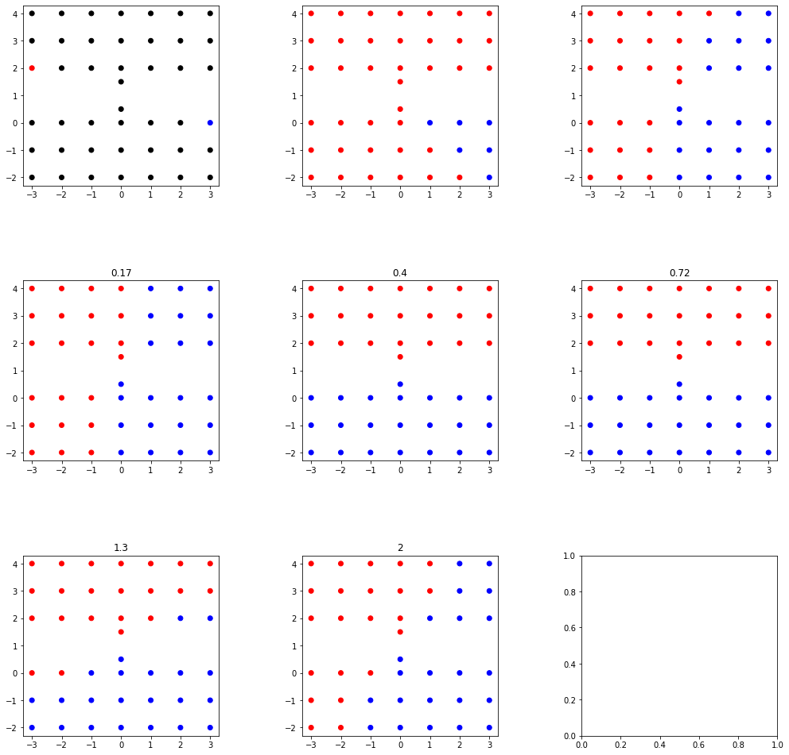
Label Propagation

Slide 20
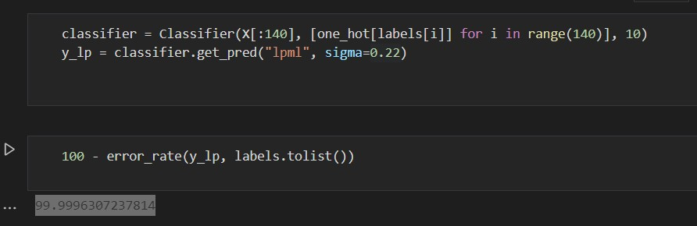

Slide 21
Limitations
▶ Memory grows linearly with data
▶ Only works with undirected graph
▶ Assumption of locality
▶ Assumption of equal importance of self-connections vs. edges to neighboring node
𝐴^{መ} = 𝐴 + 𝜆𝐼
where 𝜆 is a learnable parameter.

